Slide 1
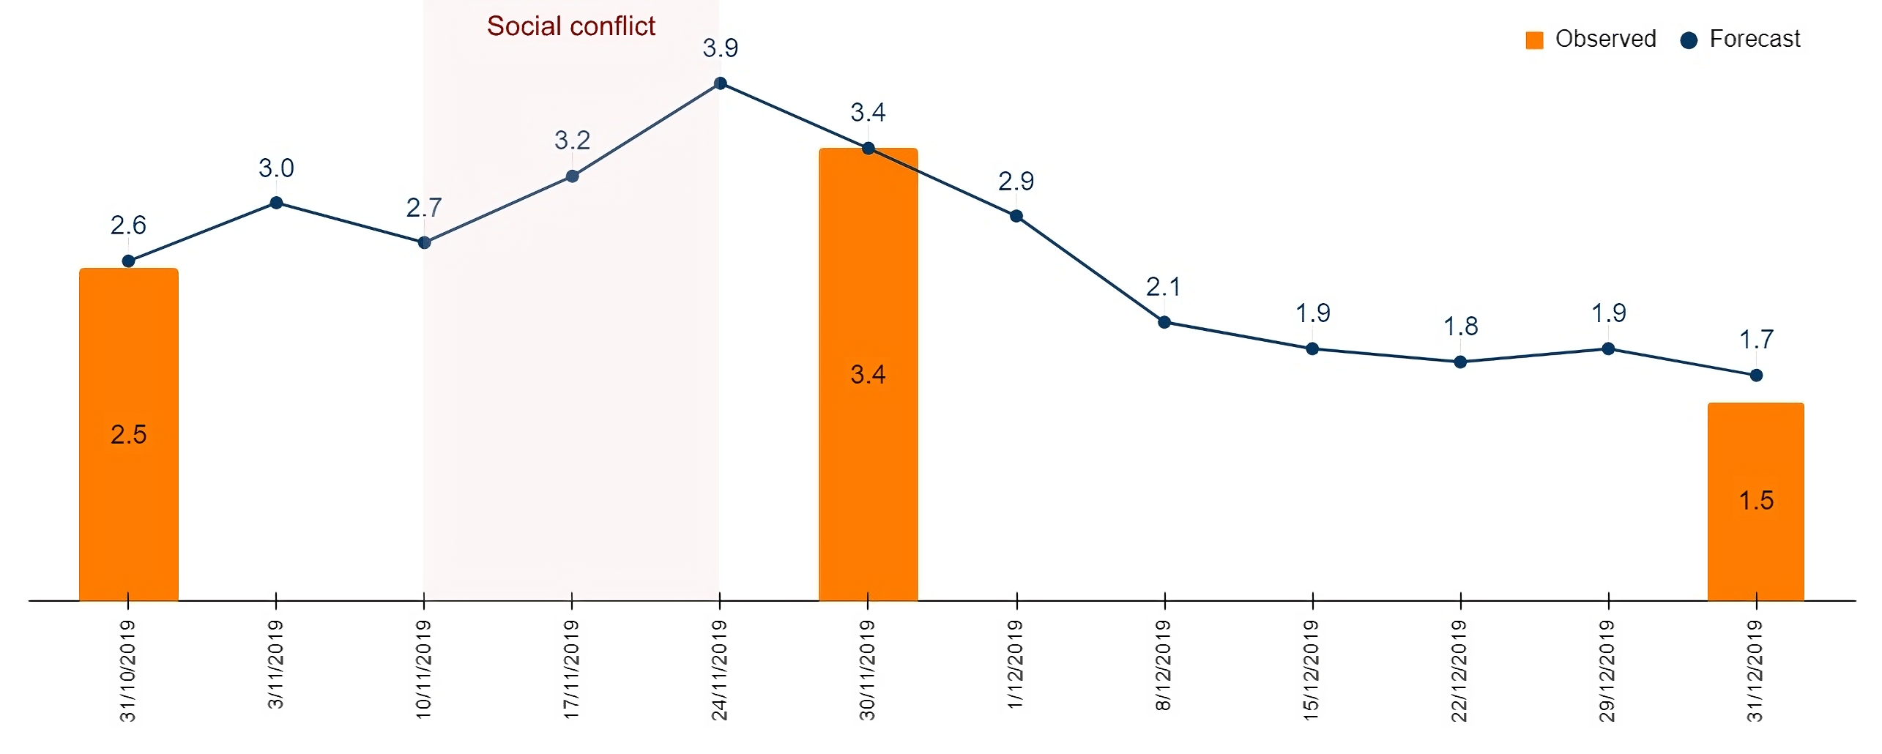
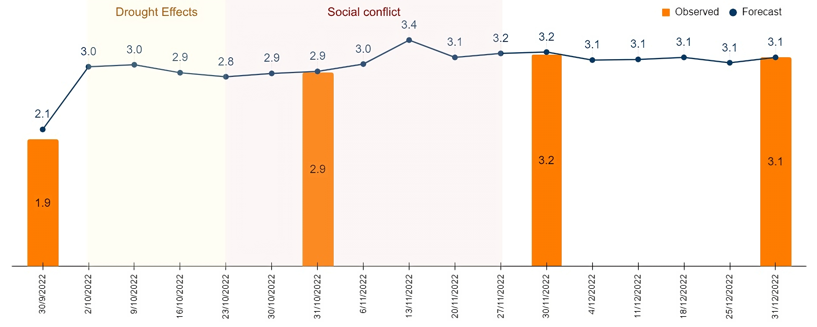

Slide 2
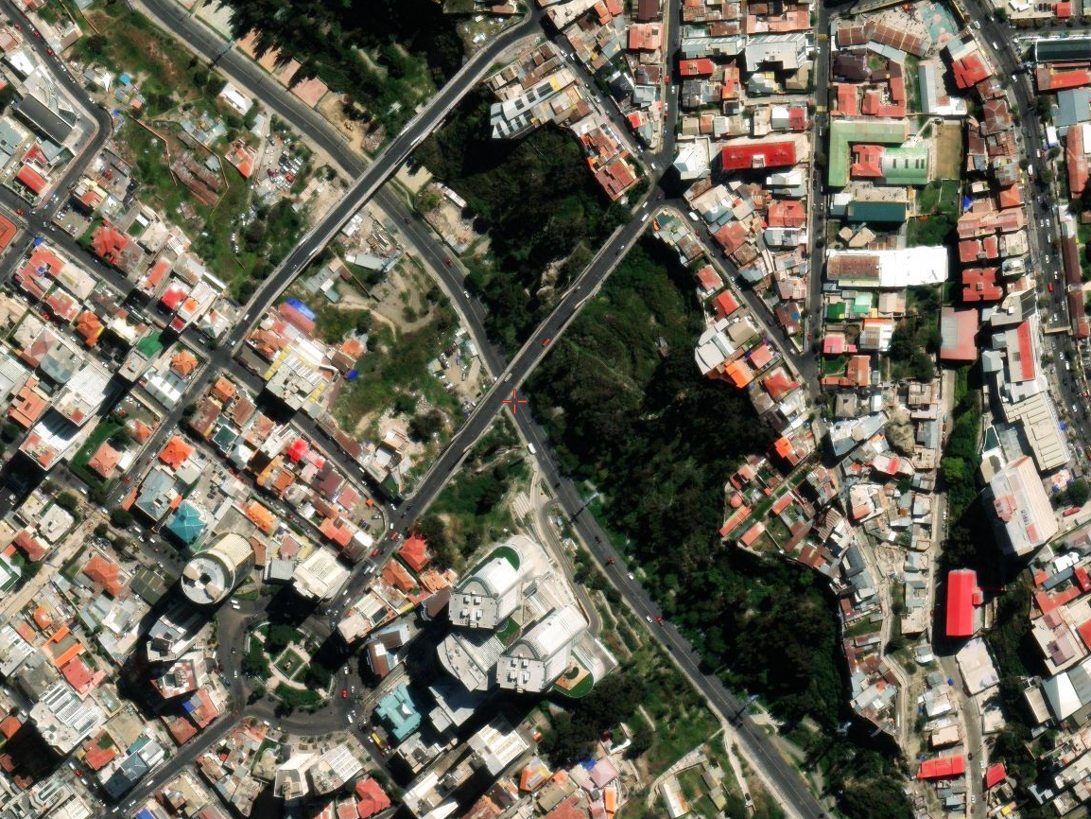

Slide 3
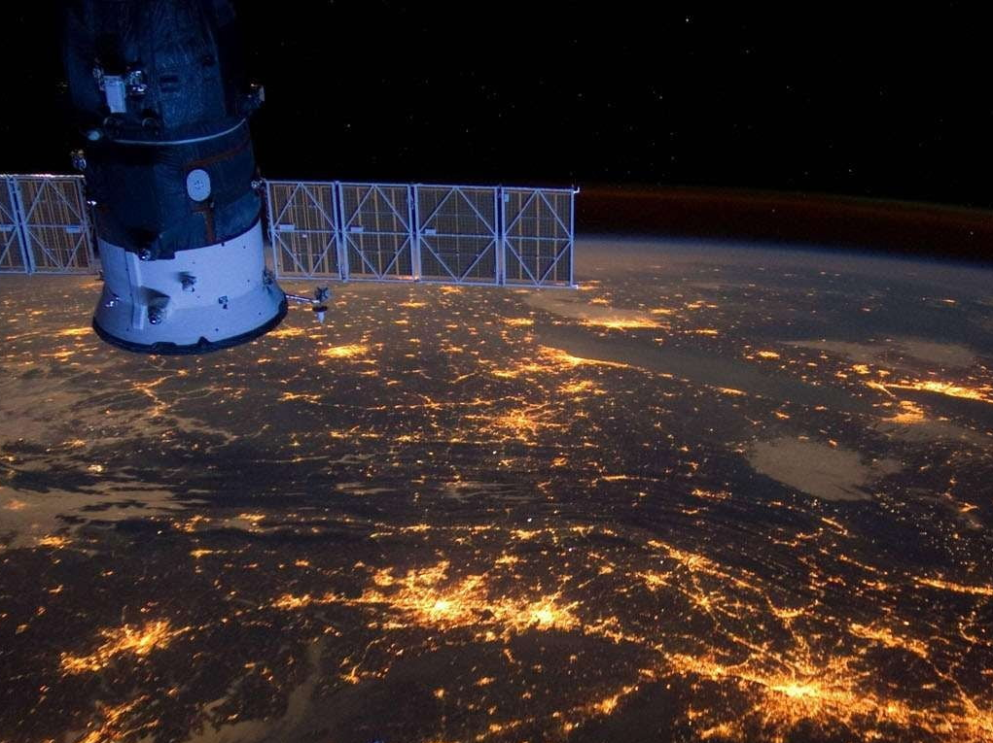

Slide 4
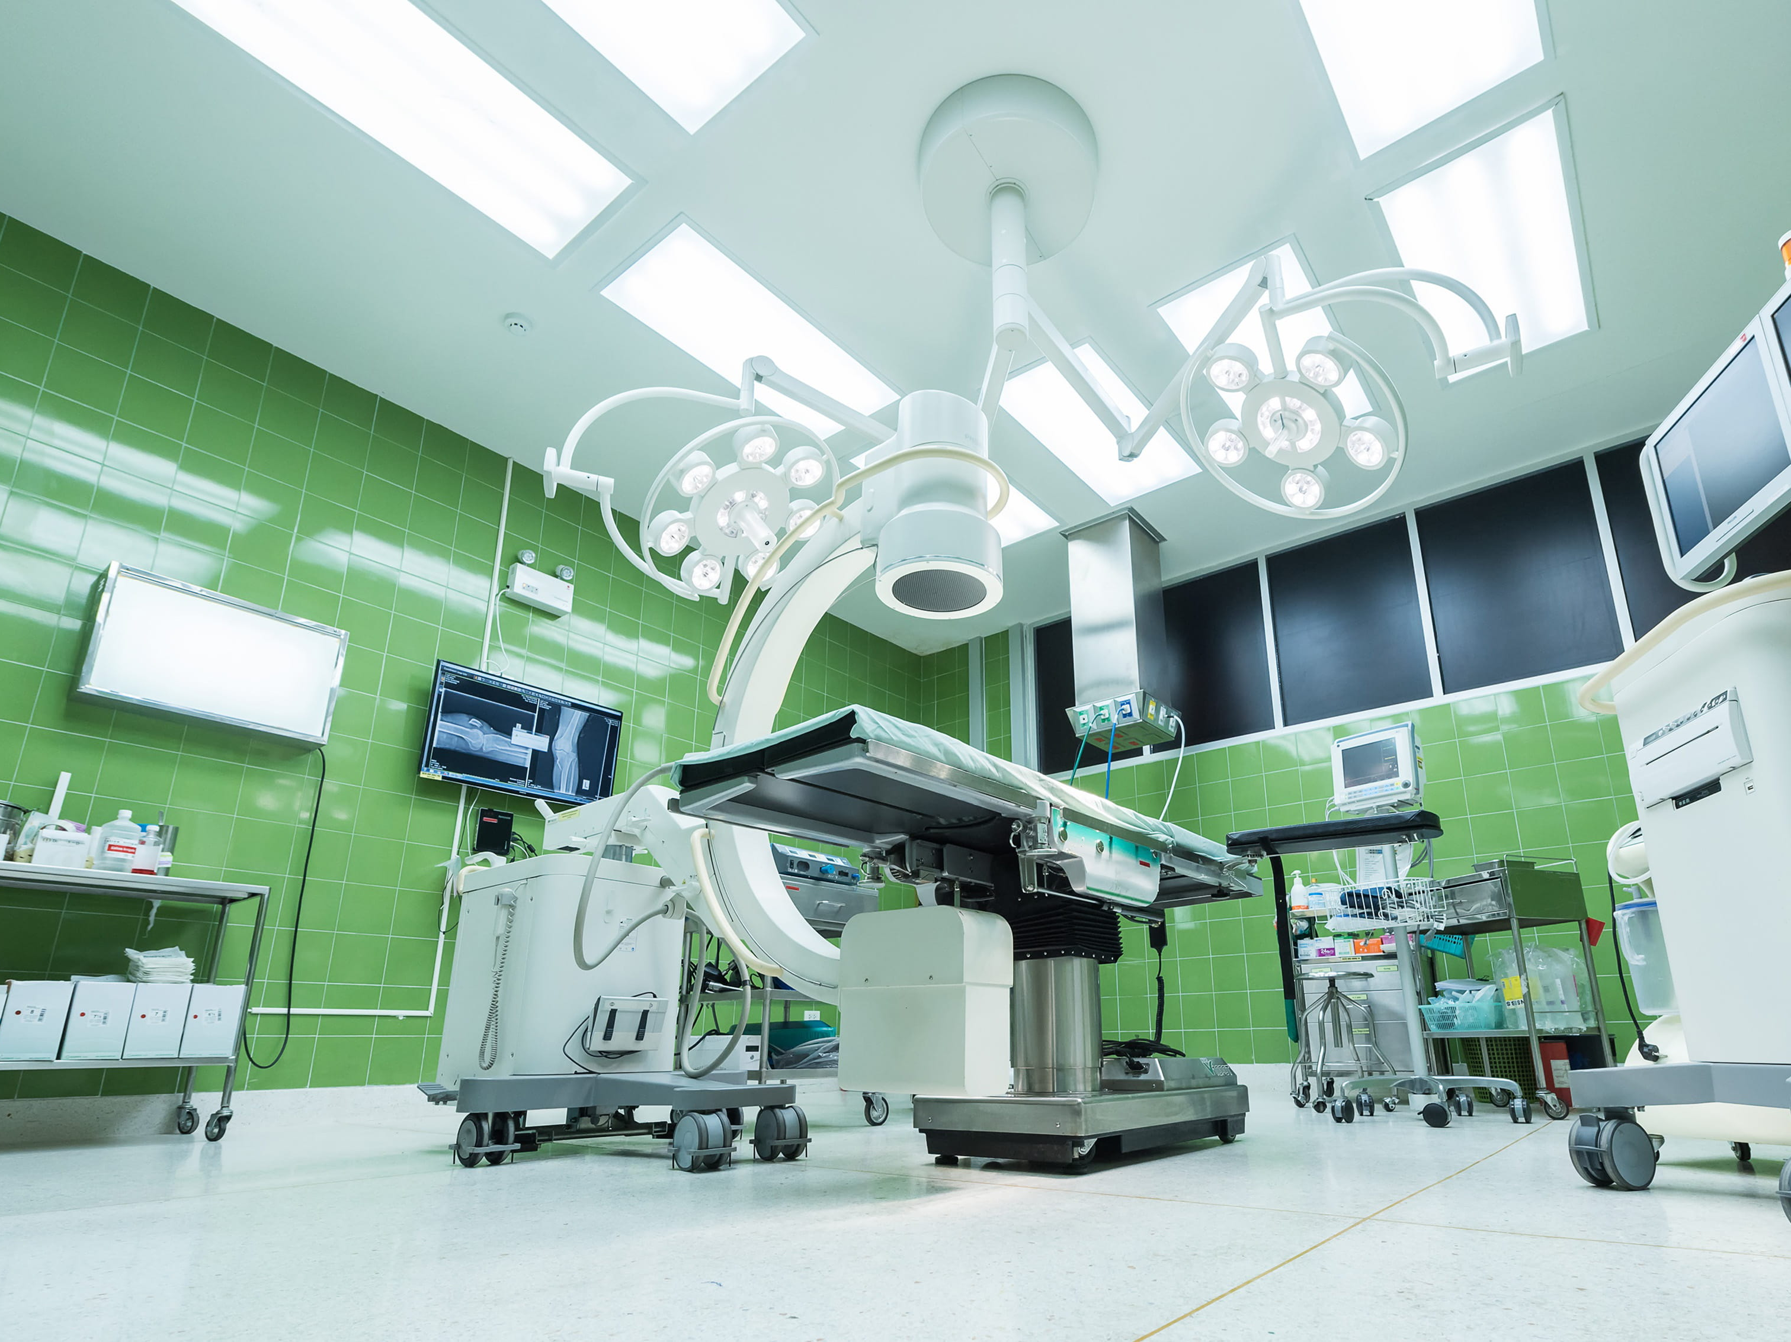


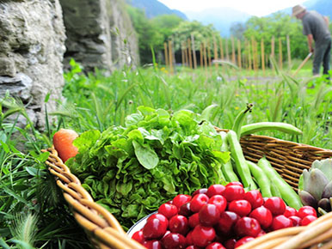

Slide 5
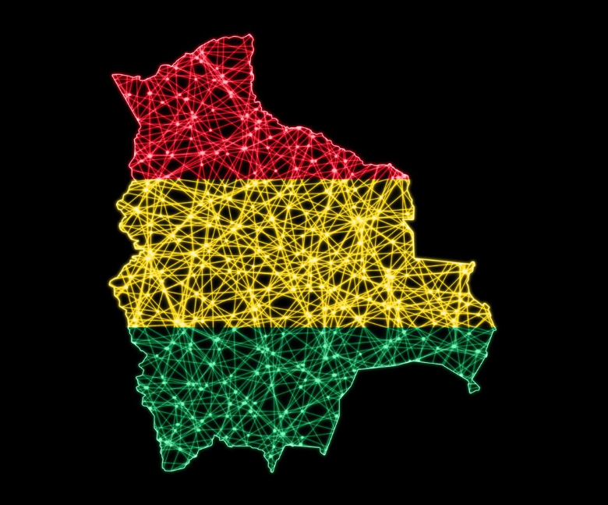

Slide 6
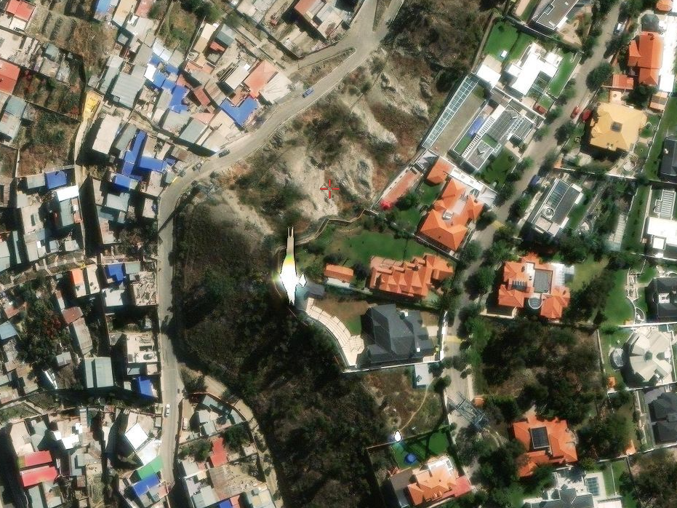

Slide 7
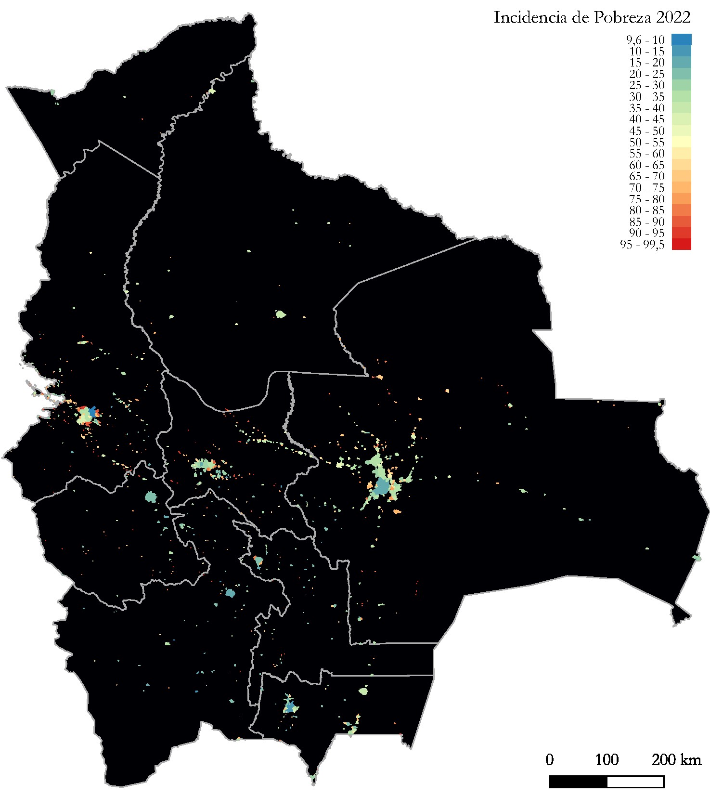
2022 Poverty Headcount Ratio

Slide 8
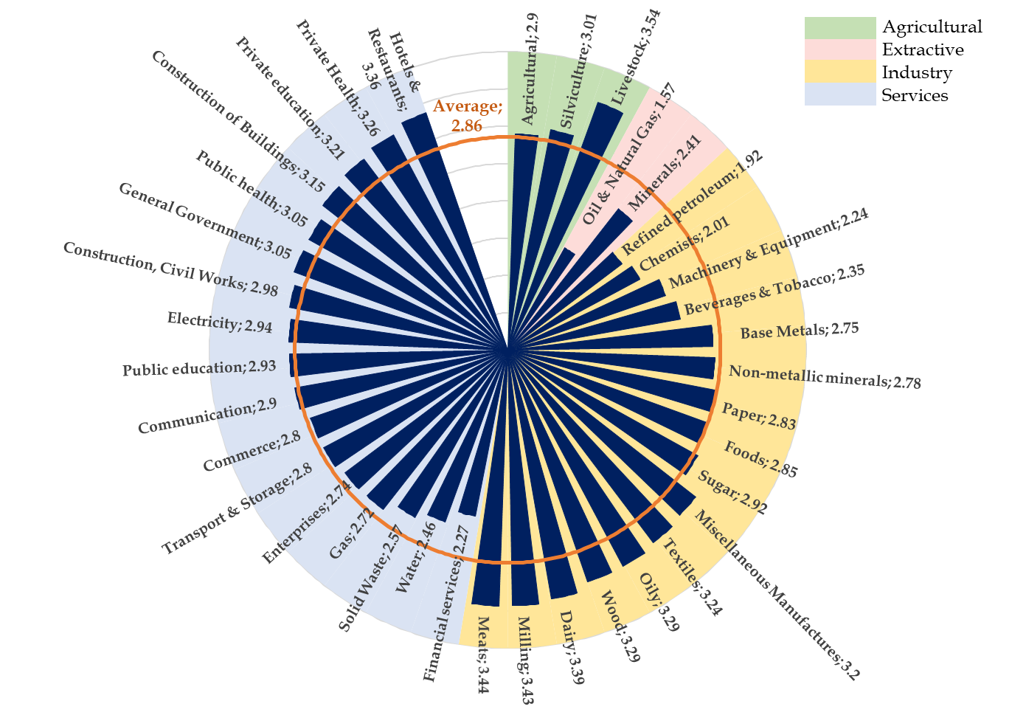

Slide 9
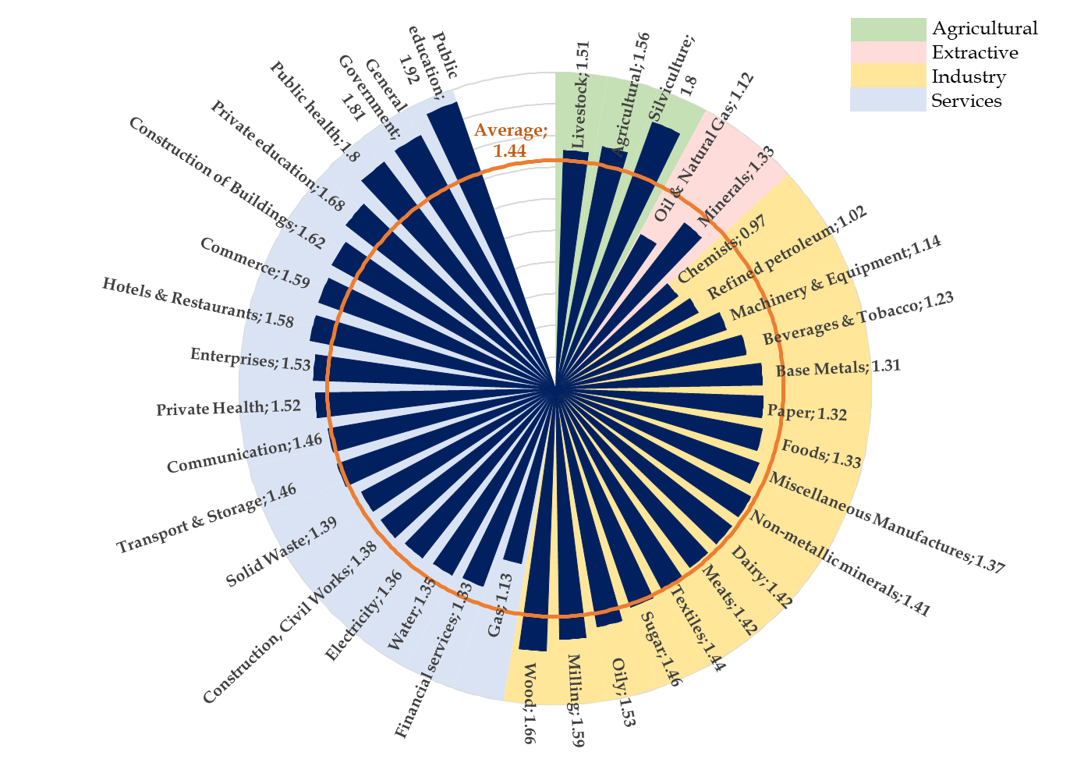

Slide 10
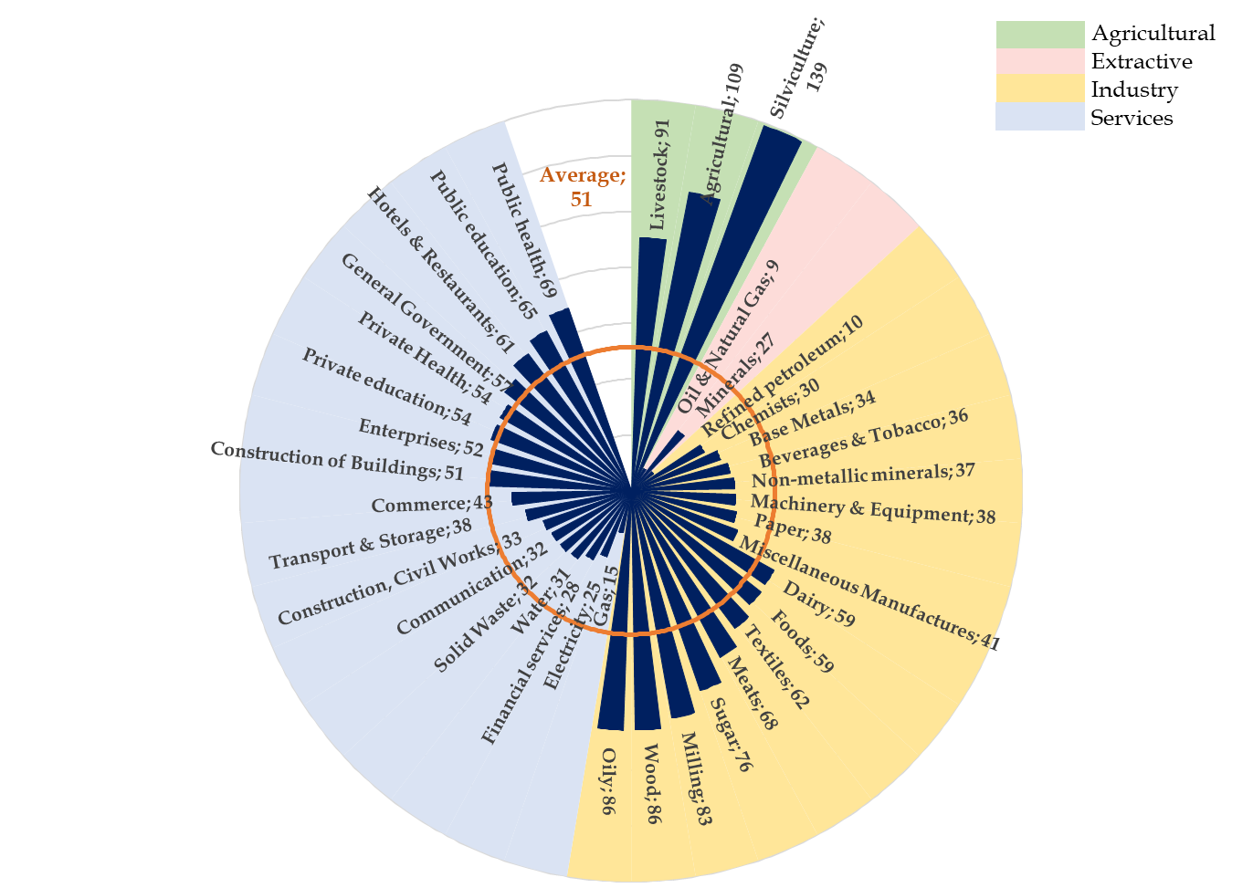

Slide 11
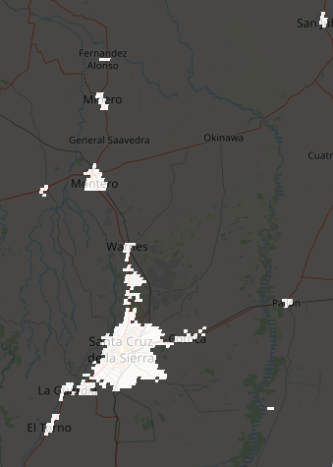
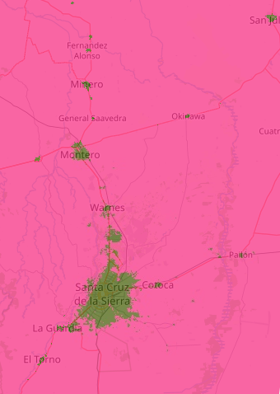
(a) Original GHSL
(b) Classified with trained RF model
Note: In the image on the left, built-up areas are identified with white color and non-built-up areas with black color. In the image on the right, built-up areas are identified with green color and non-built-up areas with pink color. Due to the spatial resolution of Landsat-8 and VIIRS night lights images, the built-up area classification image is more pixelated and, therefore, can provide more granular inputs regarding the identification of this type of area.

Slide 13
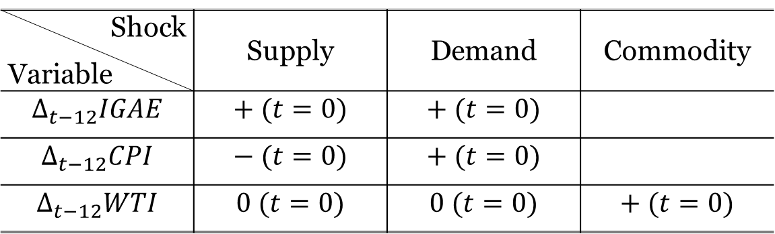
Shock Variable | Supply | Demand | Commodity
$$Δ_{t−12}IGAE$$ | $$+ (t=0)$$ | $$+ (t=0)$$
$$Δ_{t−12}CPI$$ | $$− (t=0)$$ | $$+ (t=0)$$
$$Δ_{t−12}WTI$$ | $$0 (t=0)$$ | $$0 (t=0)$$ | $$+ (t=0)$$
Note: In the image on the left, built-up areas are identified with white color and non-built-up areas with black color. In the image on the right, built-up areas are identified with green color and non-built-up areas with pink color. Due to the spatial resolution of Landsat-8 and VIIRS night lights images, the built-up area classification image is more pixelated and, therefore, can provide more granular inputs regarding the identification of this type of area.

Slide 14
